Slide 1

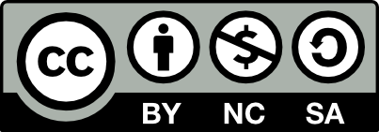

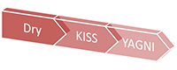
SOLID Principles in Software Design
SOLID, DRY, YAGNI, KISS
High-Quality Code
SoftUni Team
Technical Trainers
http://softuni.bg
Software University

Slide 2

Table of Contents
SOLID Principles
SRP – Single Responsibility Principle
OCP – Open / Closed Principle
LSP – Liskov Substitution Principle
ISP – Interface Segregation Principle
DIP – Dependency Inversion Principle
DRY – Don't Repeat Yourself
YAGNI – You Aren't Gonna Need It
KISS – Keep It Simple, Stupid
Factory Pattern

Slide 3
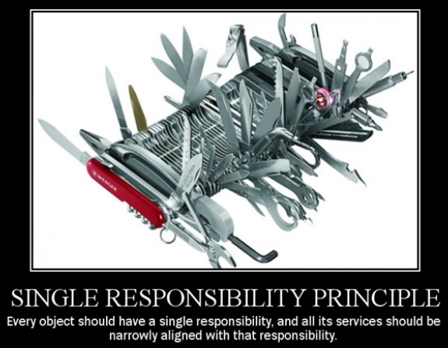
Single Responsibility Principle

Slide 4
SRP – Single Responsibility Principle
"The Single Responsibility Principle states that every object should have a single responsibility, and that responsibility should be entirely encapsulated by the class."
Wikipedia
"There should never be more than one reason for a class to change (more than one responsibility)."
Robert C. Martin "Uncle Bob"

Slide 5

SRP – Single Responsibility Principle (2)
SRP is about strong cohesion and loose coupling
Cohesion
Relation of responsibilities
Focused on single task
Coupling
Dependency on other modules
Relationship between modules
Ideal: low coupling + strong cohesion (e.g. a HDD)

Slide 6

SRP – Single Responsibility Principle (3)
Responsibility
"A reason to change"
Mapped to project requirements
More requirements → more possible changes
More responsibilities → more changes in the code
Multiple responsibilities in one class → coupling
More coupling → more errors on change

Slide 7
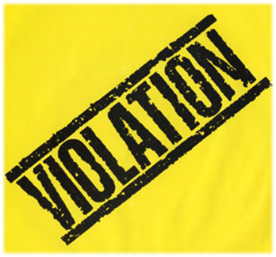

Single Responsibility Principle: Violations
Classic violations of SRP
Objects that can print / draw themselves
Objects that can save / restore themselves
Classic solutions
Separate printer class
Separate persistence class
Or use the Memento design pattern

Slide 8

SRP: Solutions and Benefits
More solutions
Multiple small interfaces (ISP)
Many small classes
Distinct responsibilities
Benefits of SRP
Flexible design
Lower coupling
Higher cohesion

Slide 9

Single Responsibility Principle
Live Demo

Slide 10
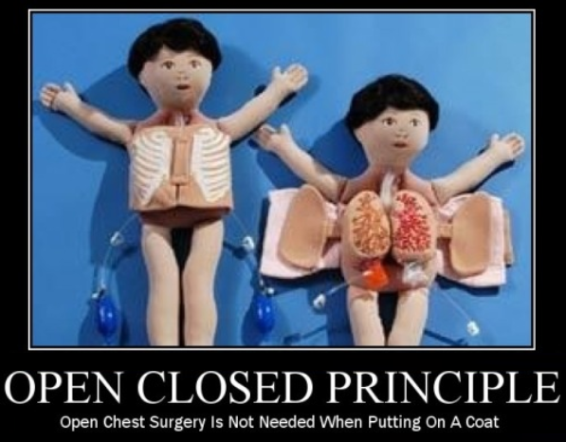
Open / Closed Principle

Slide 11
OCP – Open / Closed Principle
"The Open / Closed Principle states that software entities (classes, modules, functions, etc.) should be open for extension, but closed for modification."
Wikipedia
Open to extension
New behavior can be added later
Closed to modification
Changes to source or binary code are not required

Slide 12

OCP – Open / Closed Principle (2)
Change behavior without changing the code?!
Yes, this is possible, e.g. by inheritance or by parameterization
Rely on abstractions, not on implementations
Do not limit the variety of implementations
In object-oriented languages like C#
Use interfaces and abstract classes

Slide 13
Open / Closed Principle: Violations
Classic violations of OCP
Cascading changes through modules
Each change requires re-testing (and possible bugs)
Logic depends on conditional statements
Classic solutions
New classes (nothing depends on them yet)
New classes (no legacy coupling)

Slide 14

Open / Closed Principle: How?
Three approaches to implement the OCP
Parameters
Pass delegates / callbacks
Inheritance / Template Method pattern
Child types override behavior of a base class
Composition / Strategy patterns
Client code depends on abstraction / interface
"Plug in" model

Slide 15
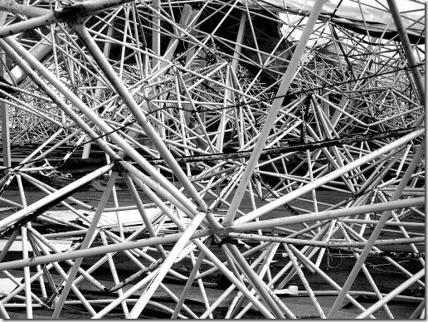
Applying the Open / Closed Principle
When to apply OCP?
Experience tell you
"Fool me once, shame on you"
Don't apply OCP at first
If module changes once, accept it
If it changes a second time, refactor for OCP
OCP adds complexity to design
TANSTAAFL – there ain’t no such thing as a free lunch
No design can be closed against all changes

Slide 16
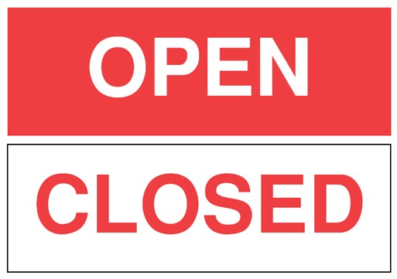
Open / Closed Principle
Live Demo

Slide 17
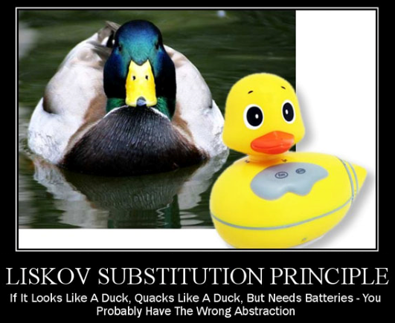
Liskov Substitution Principle

Slide 18
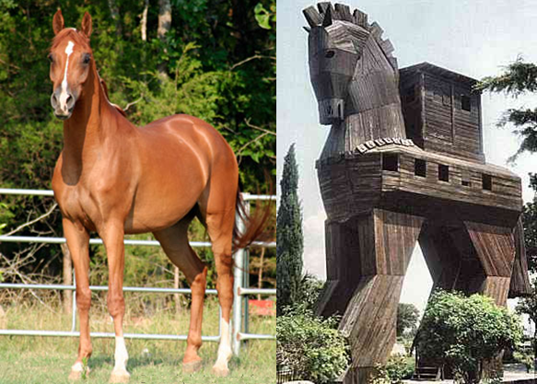
LSP – Liskov Substitution Principle
"The Liskov Substitution Principle* states that subtypes must be substitutable for their base types."
Agile Principles, Patterns, and Practices in C#
* LSP comes from MIT professor Barbara Liskov
Substitutability – child classes must not
Remove parent class behavior
Violate parent class intent

Slide 19

Liskov Substitution Principle Explained
Functions that use pointers or references to base classes must be able to use objects of derived classes without knowing it
Normal OOP inheritance
IS-A relationship
E.g. Dog is a kind of Animal
Liskov Substitution inheritance
IS-SUBSTITUTABLE-FOR
E.g. Animal is substitutable for Dog
Base
Child

Slide 20
Liskov Substitution Principle: Violations
LSP problems
Broken polymorphism
Hidden expectations for the client code
"Fixing" by adding if-then – nightmare
Classic violations of LSP
Base class does "type checking" to call different methods
Overridden methods say "I am not implemented"
Base class depends on its subtypes

Slide 21


Liskov Substitution Principle: How?
Solutions to LSP violations
"Tell, Don't Ask"
Don't ask for types
Tell the object what to do
Refactoring to base class
Common functionality
Introduce third class

Slide 22
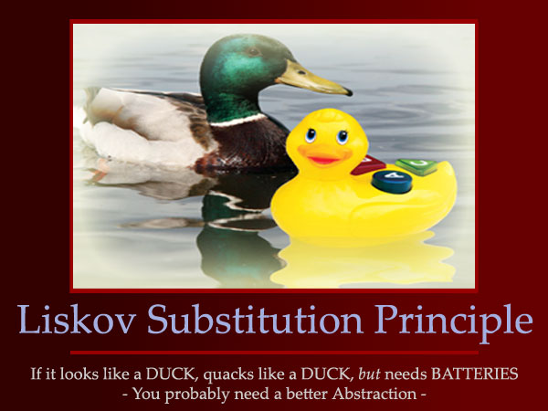
Liskov Substitution Principle
Live Demo

Slide 23
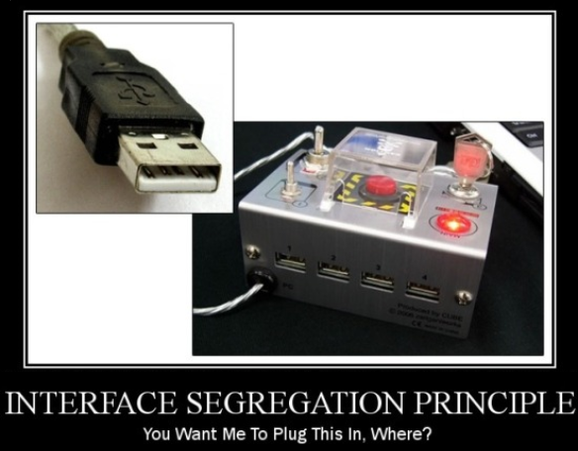
Interface Segregation Principle

Slide 24

ISP – Interface Segregation Principle
"The Interface Segregation Principle states that Clients should not be forced to depend on methods they do not use."
Agile Principles, Patterns, and Practices in C#
Segregate interfaces
Prefer small, cohesive interfaces
Divide "fat" interfaces into smaller ones

Slide 25
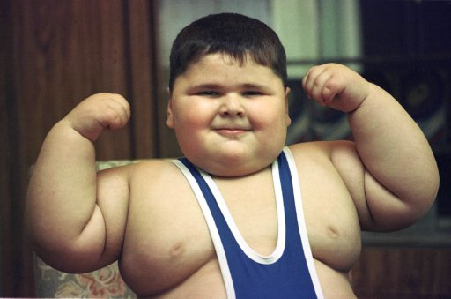
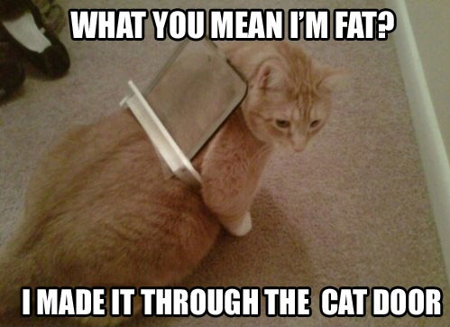
Interface Segregation Principle Explained
An interface is:
The interface type in C#
All public members of a class / module
Having "fat" interfaces leads to:
Classes having methods they do not need
Increased coupling
Reduced flexibility
Reduced maintainability

Slide 26
Interface Segregation Principle: Violations
Classic violations of ISP
Interfaces having bad cohesion
Unimplemented methods (also in LSP)
Use of only small portion of a class
How to fix "fat" interfaces?
If the "fat" interface is yours, separate it to smaller ones
If the "fat" interface is not yours, use "Adapter" pattern

Slide 27

Interface Segregation Principle: How?
Solutions to broken ISP
Small interfaces
Interfaces with strong cohesion
Focused interfaces
Let the client define interfaces
Package interfaces with their implementation

Slide 28
Interface Segregation Principle
Live Demo

Slide 29
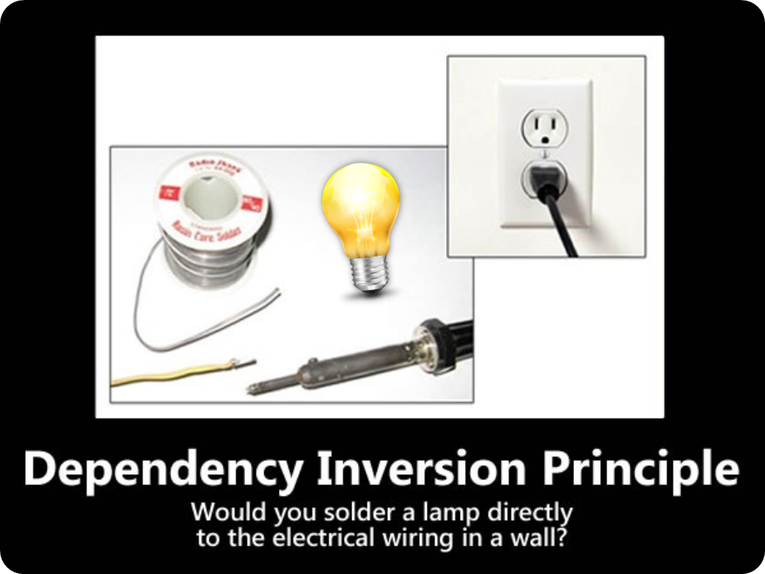
Dependency Inversion Principle

Slide 30
DIP – Dependency Inversion Principle
"Dependency Inversion Principle says that high-level modules should not depend on low-level modules. Both should depend on abstractions."
"Abstractions should not depend on details. Details should depend on abstractions."
Agile Principles, Patterns, and Practices in C#
Goal: decoupling between modules through abstractions
Programming through interfaces

Slide 31
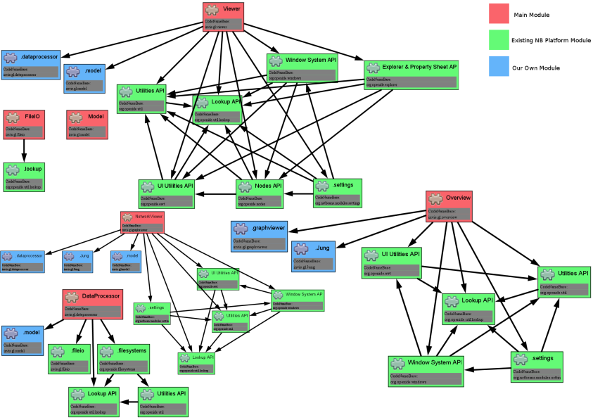
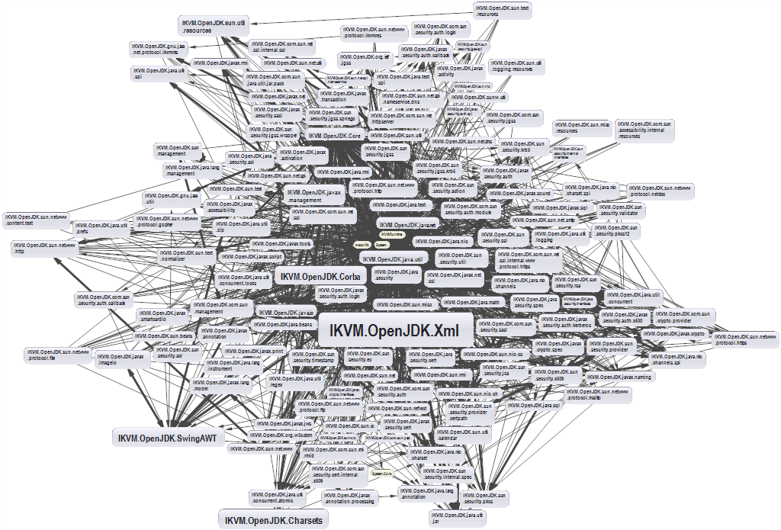
Dependencies and Coupling
Depend on abstractions
Depend directly on other modules

Slide 32
Dependency Examples
A dependency is any external component / system:
Framework
Third party library
Database
File system
Email
Web service
System resource (e.g. clock)
Configuration
The new keyword
Static method
Global function
Random generator
Console

Slide 33
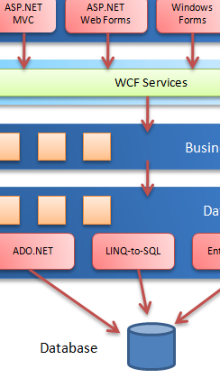
Dependencies in Traditional Programming
Traditional programming
High level modules use lower lever modules
E.g. UI depends on the Business Layer
Business layer depends on
Infrastructure, database, utilities
External libraries
Static methods (Façade for example)
Classes are instantiated everywhere

Slide 34
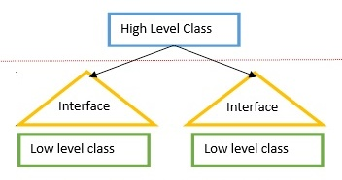

DI: Depend on Abstractions
How it should be?
Classes should declare what they need
Constructors should require dependencies
Dependencies should be abstractions
How to do it
Dependency Injection (DI)
The Hollywood principle "Don't call us, we'll call you!"

Slide 35
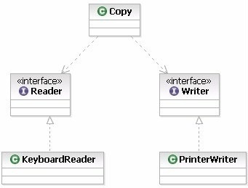
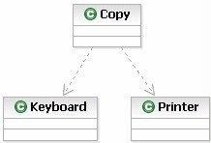
Depend on Abstractions
Depend on abstractions means to work through interfaces instead directly use dependent classes

Slide 36

Dependency Inversion Principle: How?
Constructor injection
Dependencies are passed through constructors
Pros
Classes self-documenting requirements
Works well without container
Always valid state
Cons
Many parameters
Some methods may not need everything

Slide 37
Constructor Injection – Example
public class Copy
{
private IReader reader;
private IWriter writer;
public Copy(IReader reader, IWriter writer)
{
this.reader = reader;
this.writer = writer;
}
// Read / write data through the reader / writer
}
var copy = new Copy(new ConsoleReader(), new FileWriter("out.txt"));

Slide 38

Dependency Inversion Principle: How? (2)
Property injection
Dependencies are passed through setters
Pros
Can be changed anytime
Very flexible
Cons
Possible invalid state of the object
Less intuitive

Slide 39
Property Injection – Example
public class Copy
{
public IReader Reader { get; set; }
public IWriter Writer { get; set; }
public void CopyAllChars(reader, writer)
{
// Read / write data through the reader / writer
}
}
Copy copy = new Copy();
copy.Reader = new ConsoleReader();
copy.Writer = new FileWriter("output.txt");
copy.CopyAllChars();

Slide 40

Dependency Inversion Principle: How? (3)
Parameter injection
Dependencies are passed through method parameters
Pros
No change in rest of the class
Very flexible
Cons
Many parameters
Breaks the method signature

Slide 41
Parameter Injection – Example
public class Copy
{
public CopyAllChars(IReader reader, IWriter writer)
{
// Read / write data through the reader / writer
}
}
Copy copy = new Copy();
var reader = new ConsoleReader();
var writer = new FileWriter("output.txt");
copy.CopyAllChars(reader, writer);

Slide 42

Dependency Inversion Principle: Violations
Classic violations of DIP
Using of the new keyword
Using static methods / properties
How to fix broken DIP?
Extract interfaces + use constructor injection
Inversion of Control (IoC) container

Slide 43
Inversion of Control and Dependency Injection
Inversion of control
A library / framework calls your code and injects context
Inversion of control container (IoC)
Several ways to take dependencies when programming through interfaces (dependency injection)
Constructor injection
Property injection / interface injection
Parameter injection

Slide 44
Inversion of Control Containers (IoC)
IoC containers
Responsible for object instantiation
Map interfaces to classes
E.g. maps IReader to ConsoleReader
Classes initiated at application start-up
Interfaces are registered into the container
Dependencies on interfaces are injected at runtime
Examples – StructureMap, Ninject, Spring Framework and more

Slide 45
Dependency Inversion Principle
Live Demo

Slide 46
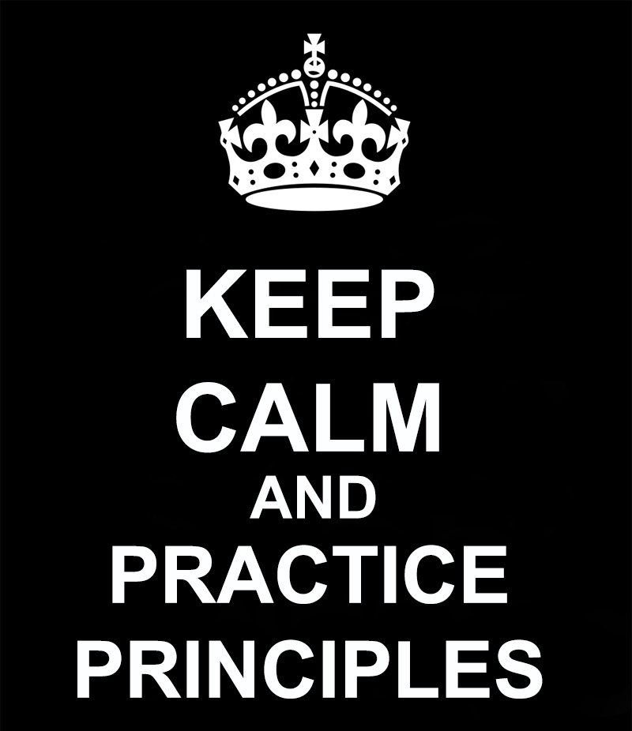
Other Principles

Slide 47
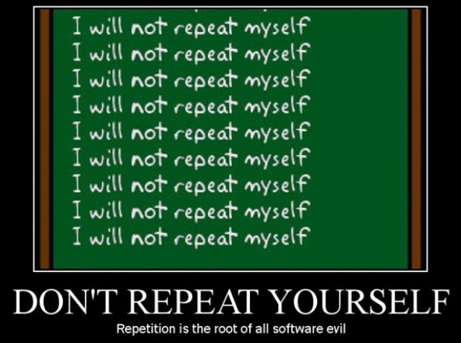
Don't Repeat Yourself (DRY)

Slide 48
Don't Repeat Yourself (DRY) Principle
"Every piece of knowledge must have a single, unambiguous representation in the system."
The Pragmatic Programmer
"Repetition in logic calls for abstraction. Repetition in process calls for automation."
97 Things Every Programmer Should Know
DRY principle variations:
Once and Only Once (OOO)
Duplication Is Evil (DIE)

Slide 49
Don't Repeat Yourself (DRY): Violations
Classic violations of DRY
Lots of duplicate code (typically copy-pasted)
Duplicated logic in multiple locations
Magic strings / values
Repeated if-then logic
Conditionals instead of polymorphism
Static methods everywhere

Slide 50
Don't Repeat Yourself
Live Demo

Slide 51

You Aren't Gonna Need It

Slide 52
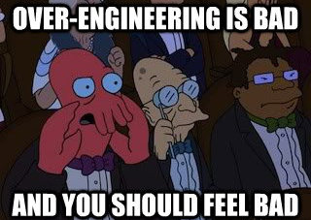
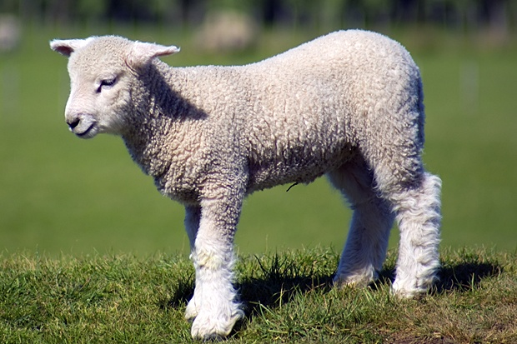
YAGNI – You Aren't Gonna Need It
"A programmer should not add functionality until deemed necessary."
Wikipedia
"Always implement things when you actually need them, never when you just foresee that you need them."
Ron Jeffries, XP co-founder

Slide 53
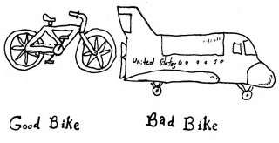
You Aren't Gonna Need It (YAGNI) Principle
Over-engineering (YAGNI) disadvantages
Time for adding, testing, improving (costs money)
Debugging, documenting, supporting
May lead to adding even more features
Larger and complicated software
May be not know to clients
Design for extension but don't implement unneeded features!

Slide 54
You Aren't Gonna Need It
Live Demo

Slide 55
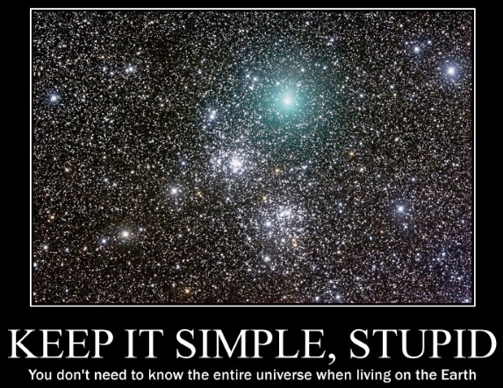
Keep It Simple, Stupid (KISS)

Slide 56
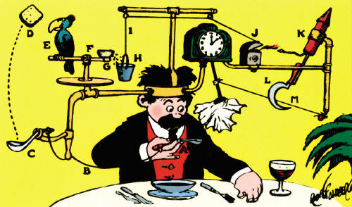

KISS – Keep It Simple, Stupid
"Most systems work best if they are kept simple."
U.S. Navy
"Simplicity should be a key goal in design and unnecessary complexity should be avoided."
Wikipedia

Slide 57
KISS – Keep It Simple, Stupid: Violations
Typical violations of KISS
Over-engineering (you need a bike, but build an aircraft)
Using design patterns when not needed
Using dependency injection and IoC for simple applications
Using complex framework for simple tasks
Using "enterprise" frameworks
Some languages (like C#) can sometimes be "heavy"

Slide 58
KISS Principle
Live Demo

Slide 59
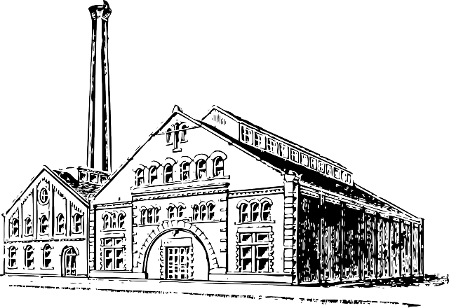
Factory Pattern
Simple, Method and Abstract Factory

Slide 60
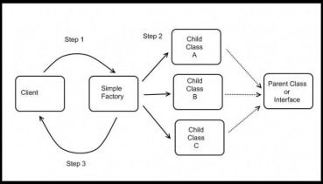
Simple Factory
The Simple Factory creates (returns) one of many classes directly
This is not a Pattern
Often mistaken with the Factory Pattern
Simple Factory vs. Factory Method vs. Abstract Factory
It is used quite often
This is the preparation for the real Pattern
Export the object creation in one place
If we make changes, we make them in one place
We can hide complex object creation
Provides a higher level of abstraction

Slide 61
Simple Factory – Example
public IStudent CreateStudent(StudentType type)
{
switch (type)
{
case StudentType.Online:
return new OnlineStudent();
case StudentType.Onsite:
return new OnsiteStudent();
}
}
Or use .NET’s Activator class

Slide 62
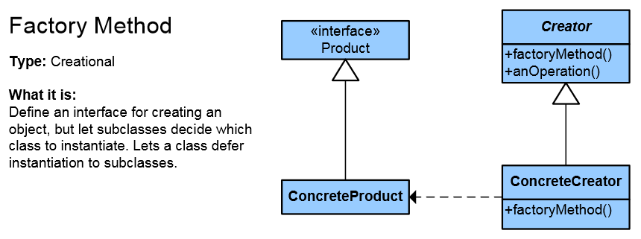
Factory Method
Objects are created by a separate method
Produces objects as normal Factory
This allows achieving higher reusability and flexibility in the changing applications
http://www.dofactory.com/net/factory-method-design-pattern

Slide 63
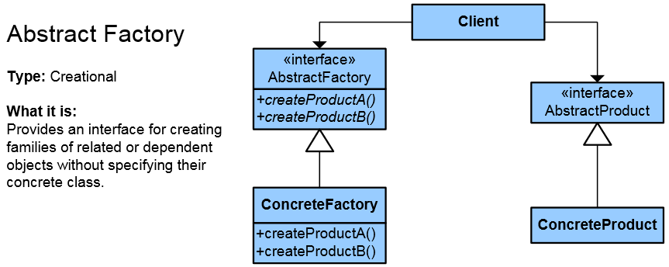
Abstract Factory
Abstraction in object creation
Create a family of related objects
The Abstract Factory Pattern defines an interface for creating sets of linked objects
Without knowing their concrete classes
Used in systems that are frequently changed
Provides a flexible mechanism for replacement of different sets
http://www.dofactory.com/net/abstract-factory-design-pattern
Notes:
Множество – йерархия, библиотека от класове, някаква съвкупност от свързани, зависими обекти
Множеството може ли да е само един обект?

Slide 64

SOLID Principles in Software Design
Exercises in Class

Slide 65

Summary
SOLID Principles
SRP – Single Responsibility Principle
OCP – Open / Closed Principle
LSP – Liskov Substitution Principle
ISP – Interface Segregation Principle
DIP – Dependency Inversion Principle
DRY – Don't Repeat Yourself
YAGNI – You Aren't Gonna Need It
KISS – Keep It Simple, Stupid
Factory Pattern

Slide 66
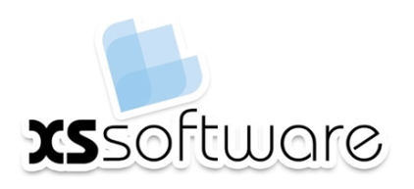


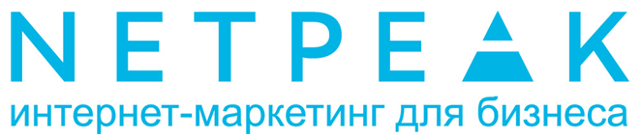




SOLID Principles in Software Design
httpshttps://softuni.bg/courses/oop/

Slide 67

License
This course (slides, examples, demos, videos, homework, etc.) is licensed under the "Creative Commons Attribution-NonCommercial-ShareAlike 4.0 International" license
Attribution: this work may contain portions from
"Fundamentals of Computer Programming with C#" book by Svetlin Nakov & Co. under CC-BY-SA license
"High Quality Code" course by Telerik Academy under CC-BY-NC-SA license

Slide 68






Free Trainings @ Software University
Software University Foundation – softuni.org
Software University – High-Quality Education, Profession and Job for Software Developers
softuni.bg
Software University @ Facebook
facebook.com/SoftwareUniversity
Software University @ YouTube
youtube.com/SoftwareUniversity
Software University Forums – forum.softuni.bg

